Slide 1

Wells Fargo Capstone Project
Batch 4 Team -1
BANK ADMIN PORTAL
Presented By:
Gulshan Kumar
Sanjeev
Dhruvi
Aniket
Anubhav
Tech Used:
ReactJs
SpringBoot
MySql

Slide 2
TABLE OF CONTENT
1. Problem Statement
2. User cases
3. Implementation
4. Testing
5. Conclusion

Slide 3
Introduction

Slide 4

Problem Statement
Admin should log in to perform activities
They can add a new branch, open account.
They can close an account, delete a branch
They can also fetch all the customers and all the branch details.

Slide 5
User Stories
US-01
Admin Authentication
Return to Menu
Sign in Page on wrong credentials
US-02
Menu functionality display
Add and delete customer and branch
US-03
New branch registration
Only registered customer for account opening
US-04
Fetch all customer
Open account form display
Branch id automated selection
US-05
Display all customer account
Use table for display
US-06
Display all branch details
Option to delete a branch

Slide 6
Implementation

Slide 7
Work Flow
User
User
Account
Account
Repository
Service
Controller
Customer
Customer
Loan
Loan
Branch
Branch
Frontend
Models

Slide 8
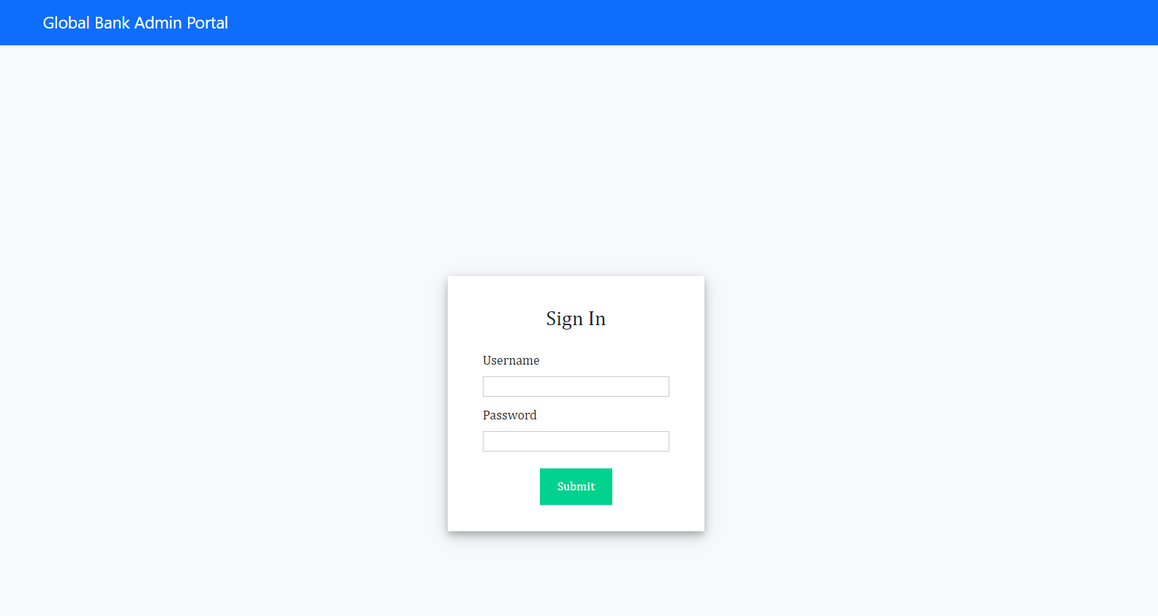

Slide 9
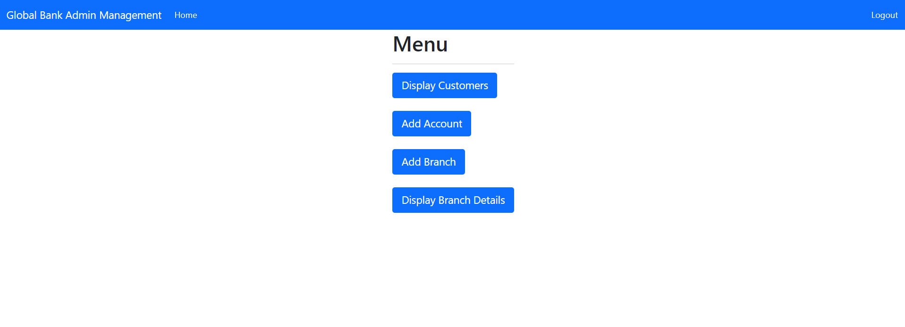

Slide 10
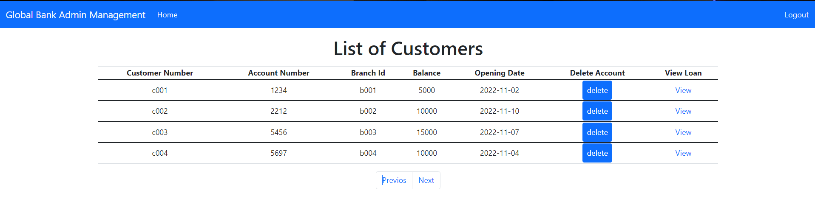

Slide 11
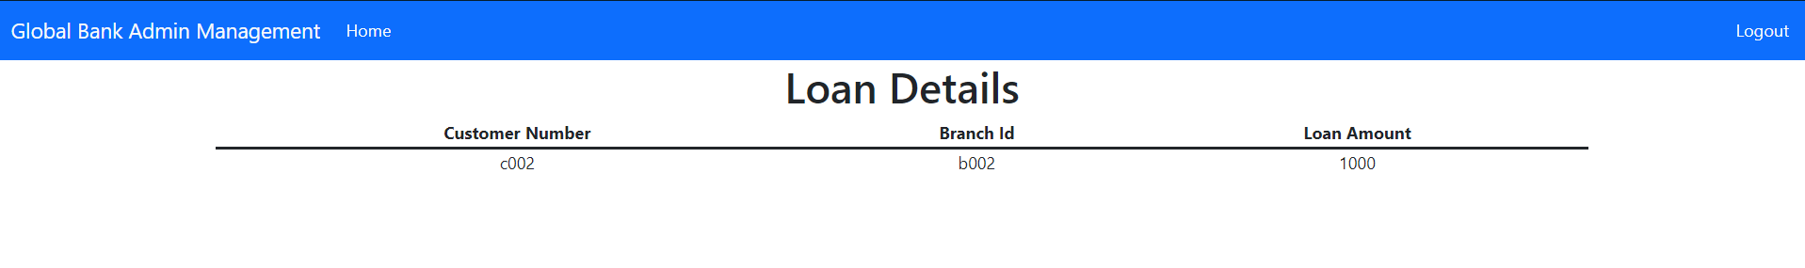

Slide 12
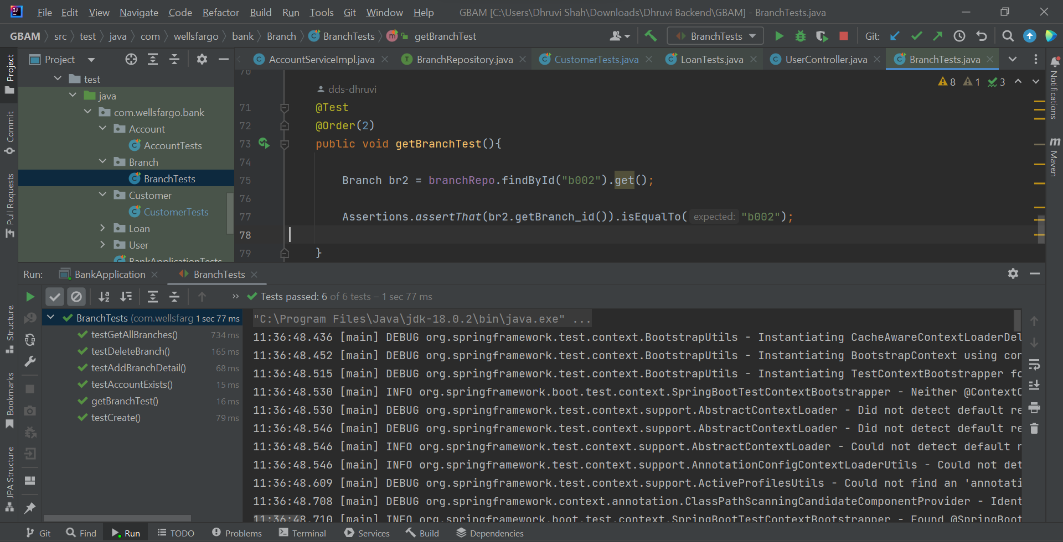
Unit Testing

Slide 13
Q&A

